Slide 1
Deep Learning Fundamentals
ML to DL to Transformers to LLMs
Week: 01

Slide 2
What to Expect:
Understanding of Machine Learning Models
Types of Machine Learning
Understanding of Neural Networks
Key terminologies
Types of Neural Networks
Frameworks to work with Neural Networks
Transfer Learning and use cases
Introductions to Transformers

Slide 3
Machine Learning ?
Traditional Programming: Rules + Data → Output
Machine Learning: Data + Output → Learn Rules

Slide 4
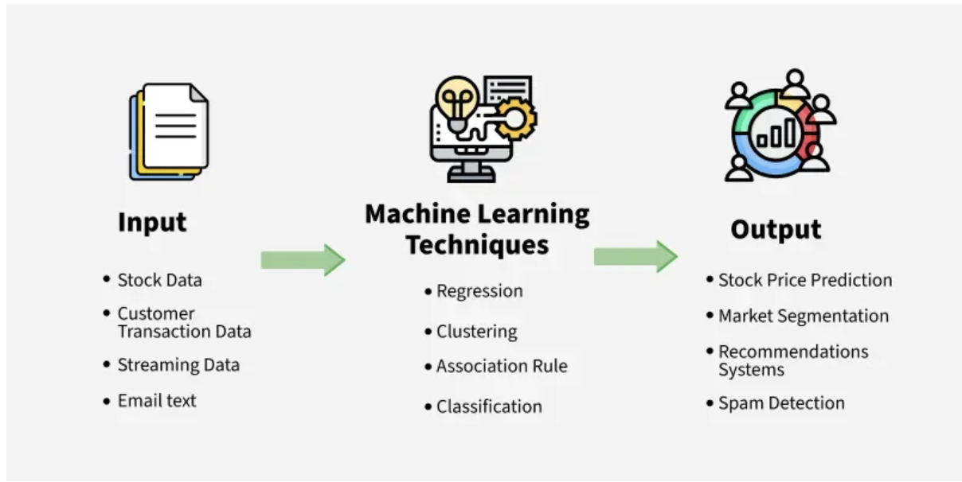

Slide 5
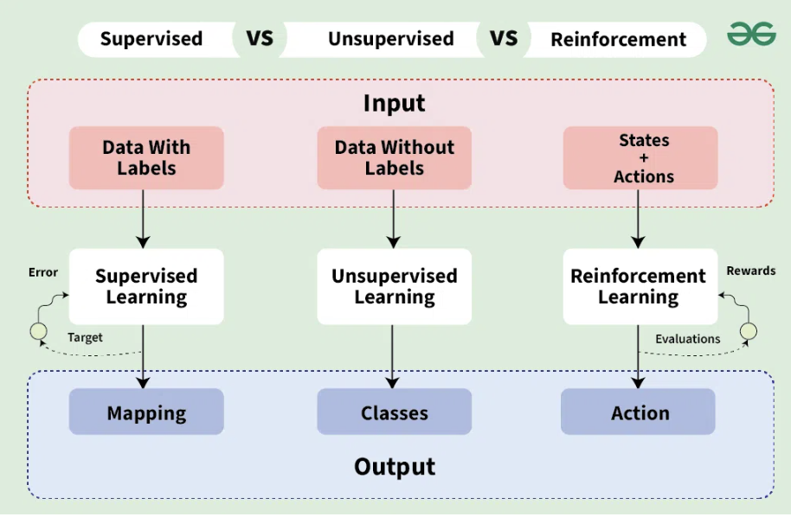
Types of Machine Learning :
Supervised: From Labelled data
Spam Detection
Sales forecast
Unsupervised: from un-labelled data
Customer segmentation based on purchasing behaviours
Reinforcement Learning: (Action → Reward/Penalty → Learn)
Self-driving cars

Slide 6
Neural Networks ?
A neural network is a system of algorithms inspired by the human brain that processes information and makes predictions.
It consists of layers of "neurons" that process data step by step.
🔵 Input Layer → 🟡 Hidden Layer → 🔴 Output Layer

Slide 7
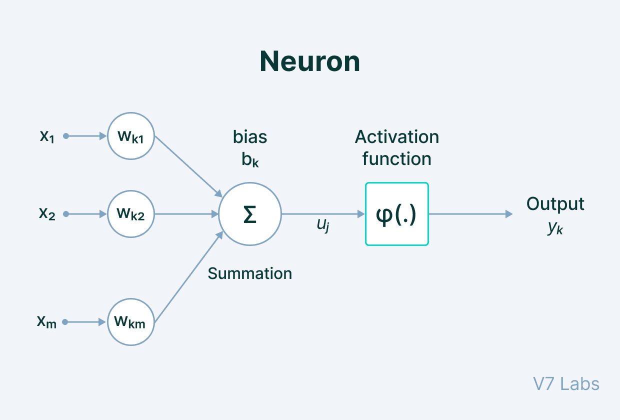
Some Key Terms:
Neurons (Nodes)
Like brain cells, neurons receive inputs, process them, and pass output.
Weights
Determines how important an input is.
Higher weight = More impact on decision.
Bias
A constant value that helps shift outputs for better learning.
Activation Function
Decides whether a neuron should "fire" or not.

Slide 8
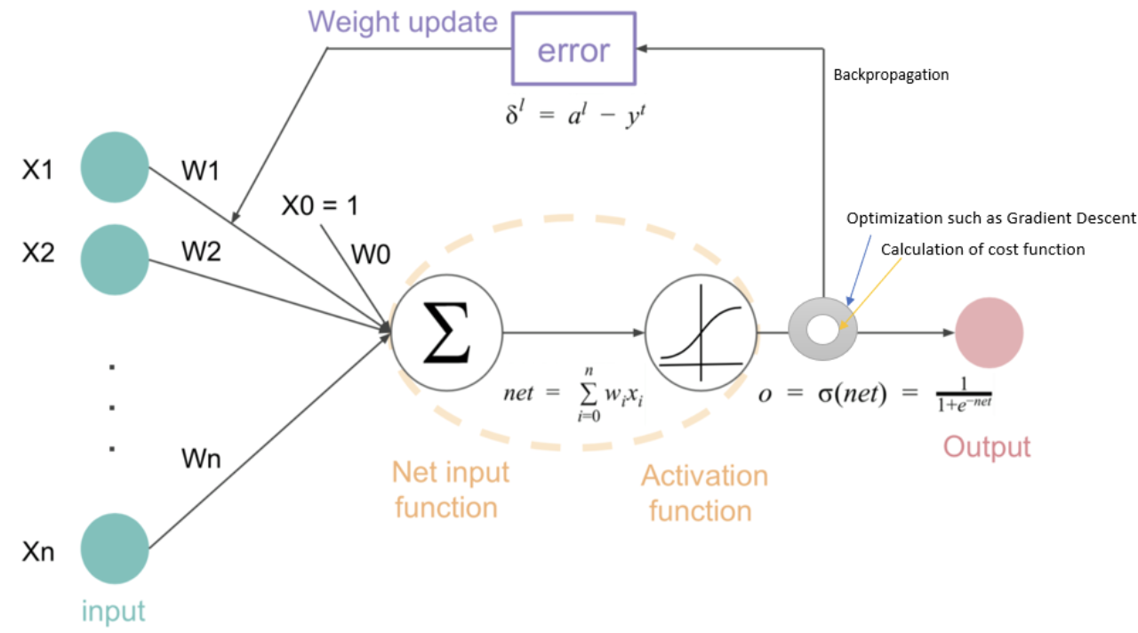
Some Key Terms:
Layers:
Group of neurons organized together in connection to adjustant layers.
Forward Propagation:
passing data from input layers through hidden layer to output layer.
Backpropagation:
Adjust the weights and biases based on the error
Loss functions:
Function to qualify the error between the predicted and actual output guiding the optimization process
Optimization algorithms like Gradient descent:
to find the optimal values for weights and biases to minimize the loss function

Slide 9
Types of Neural Networks:
Feedforward NN
Data/information flows in one direction
No feedback mechanism
Use cases: Regression, Classification
Recurrent NN
Feedback loop exists allowing it to process sequential data
Use case: Time series analysis, NLP, etc.
LSTM is a type of RNN designed to handle long sequences
Convolutional NN
Works on a filter window to extract features from input
Use case: image or video processing, shape recognition and other vision related tasks

Slide 10
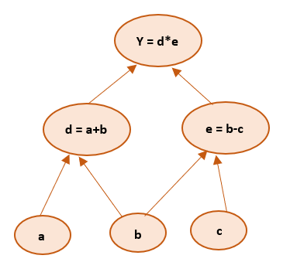
Frameworks to handle NN: TensorFlow & Keras
Open source framework by Google
Tensors: Multi-dimensional array used to store data
Scaler (1),
Vector ([1,2,3]),
Matrix ([1,2],[3,4]),
3D Tensor ([[[1, 2], [3, 4]], [[5, 6], [7, 8]]])
Computational graph: Computations can be represented as Directed Acyclic Graphs (DAG)
Eager Execution vs Graph Mode
Different ways of executing operations in ML
Performance
Portability vs Debugging
Compilation
Keras: high level framework for ease in building and training NN.
Provides sequential (linear) and functional flow in NN

Slide 11
Learning Goals for Session: 02
Transfer Learning
Transformer architecture
AI vs GenAI
LLM
Different types of LLM
Key Terminologies
Hands on for some key concepts

Slide 12
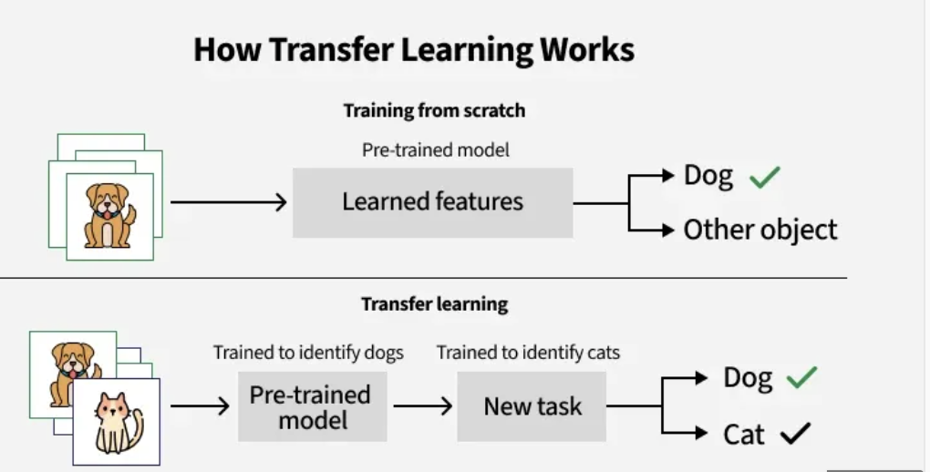
Transfer Learning:
ML technique where knowledge gained from pre-trained models on one task is reused for a new related task.
Examples:
Voice detection --> wake up words
Movement detection --> Face detection

Slide 13
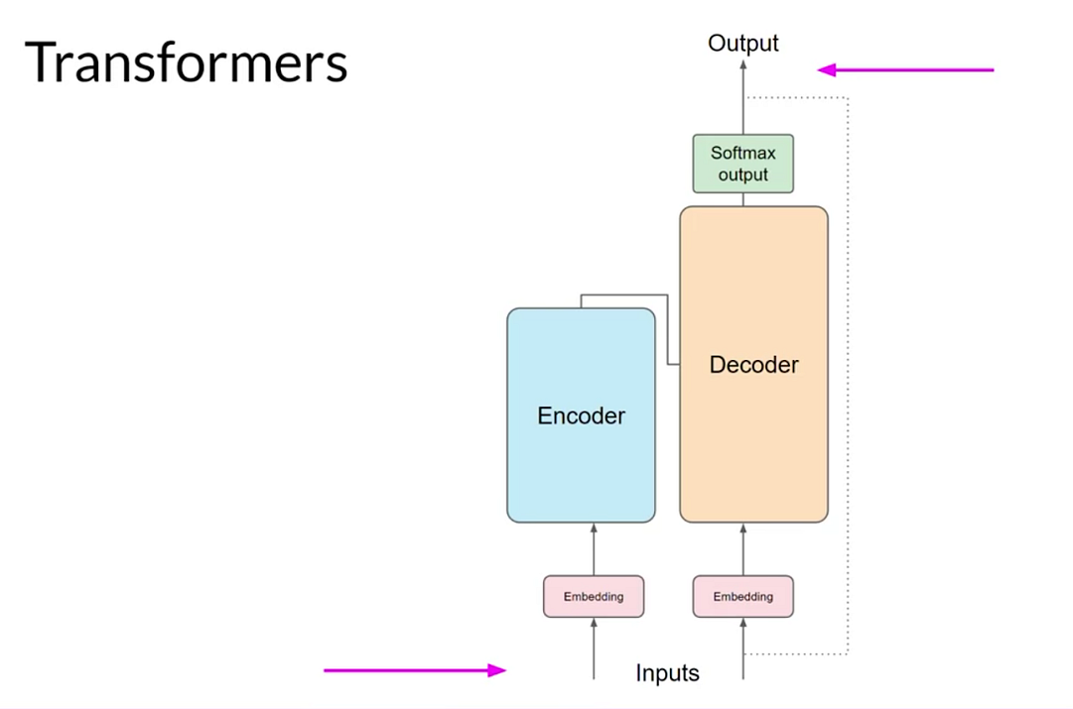
Machine Learning → Transformers → Large Language Models
A Transformer is a neural network architecture that processes entire sequences at once instead of step by step.
Overcome the short comings of neural networks (attention mechanism and positional encoding)
Input converted to embeddings (sparse or dense)

Slide 14
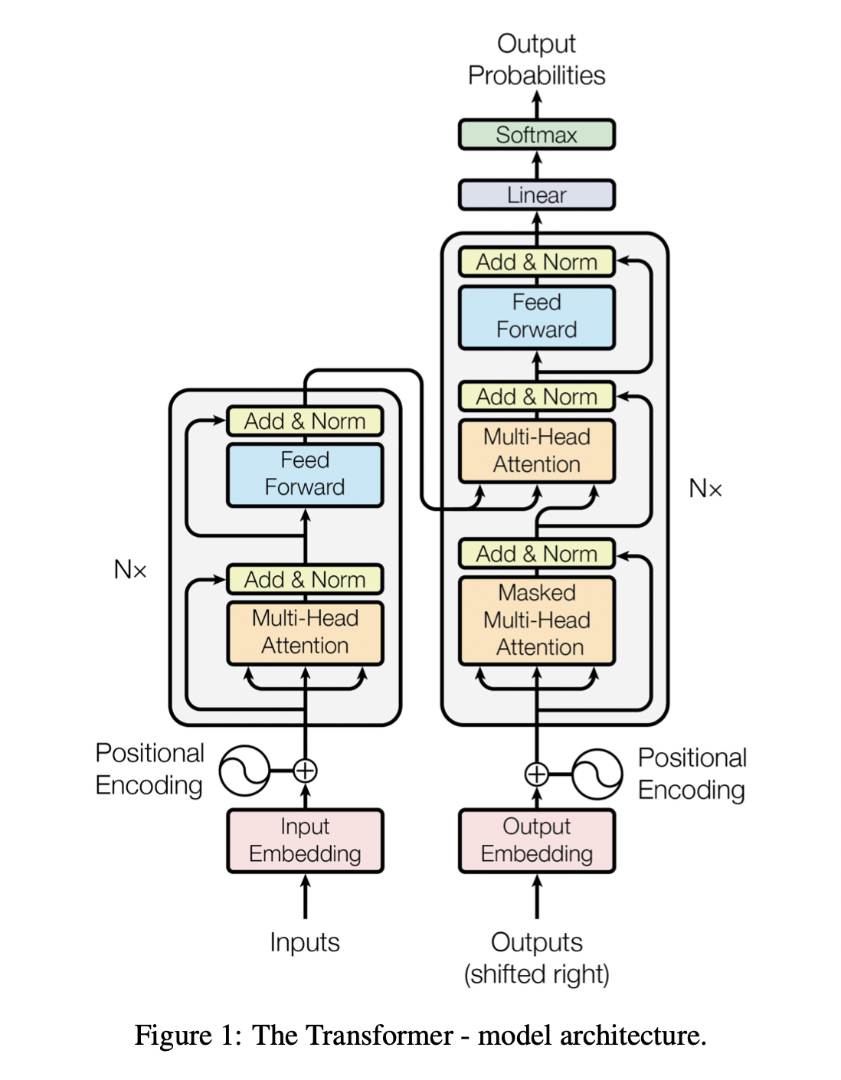
Attention is All You Need
Allows model to focus on different parts of input sequence
Process and interpret all input tokens at once (self-attention)
Helps capture long – range dependencies
Multi-headed attention: allows model to focus on different aspect or relationship between tokens
Normalized vectors in order to keep the same scale
Softmax as activation function

Slide 15
Let's Discuss AI vs GenAI ...

Slide 16
Types of LLM
Open-source vs Close-source
Instruct model vs Chat models vs Reasoning models

Slide 17
Large Language Models
Key Terms:
Tokens
Tokenisation (link)
Context window
Embeddings
Semantic search & cosine similarity
Rate limit
Temperature
Hallucination
Prompt
Zero shot
Few shot
Parser
Popular Frameworks:
LangChain
LlamaIndex

Slide 18

Questions... ?

